Slide 1
The Dangers of Flight
A review of 30 years of accidents and fatalities (1985 – 2014)

Slide 2
Is air travel riskier now than in the past?
Although no perfectly safe form of travel exists which is completely devoid of danger, travel by air has consistently received the distinction that it is the safest way to travel, especially when compared to travel by automobile
Recent incidents which have received substantial media attention have caused some to claim that this is no longer the case by showing an increase in fatality totals and accidents
Our review of the data concerning airline safety presents a counter to these claims

Slide 3
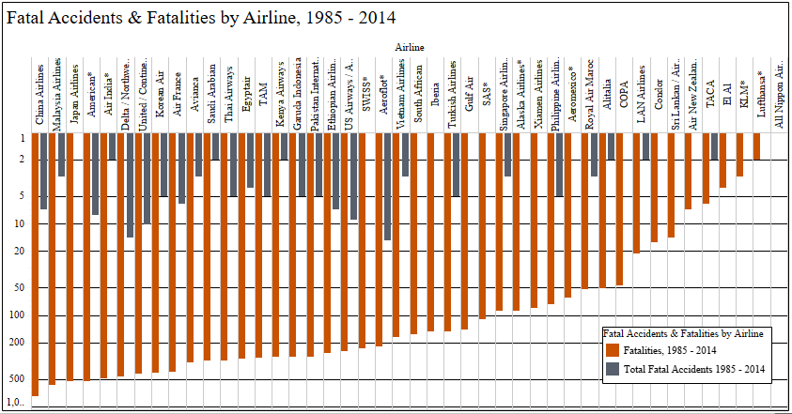
As shown here, there have been numerous fatal accidents and fatalities between 1985 and 2014, but the majority of these accidents have occurred in larger airlines which have more aircraft in their fleets – therefore the proportion of accidents still stays relatively low
* – includes regional subsidiaries

Slide 4
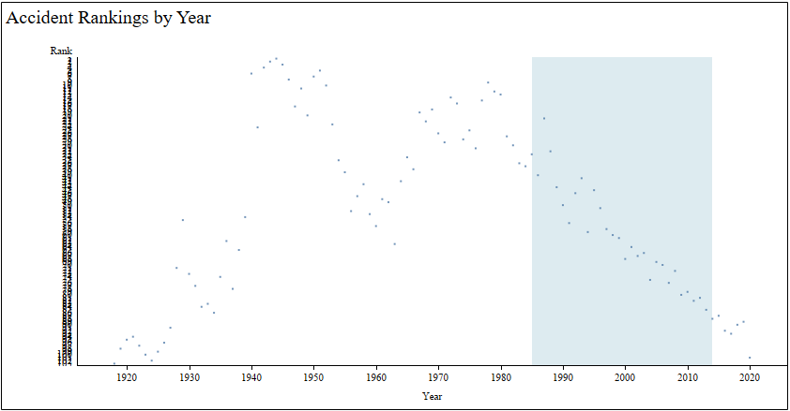
This chart shows the ranking of all accidents that have occurred per year with air travel from 1918 to the present, with the ranking showing those years with the highest number of accidents showing at the top of the chart. The blue highlighted area is for the years 1985 through 2014 – not only is this time frame showing many of the lower ranked years for accidents, but also a steady downward trend as time moves on; the total number of accidents per year are decreasing

Slide 5
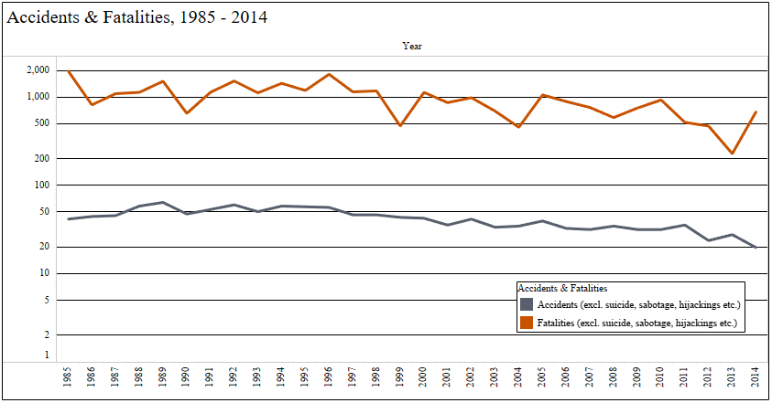
Further demonstrating this trend is the following chart, which shows a steady trend of declining accidents and fatalities over the course of the referenced 30-year timeframe – although there have been major accidents which have gained worldwide attention, the overall level of dangers in air travel are decreasing

Slide 6
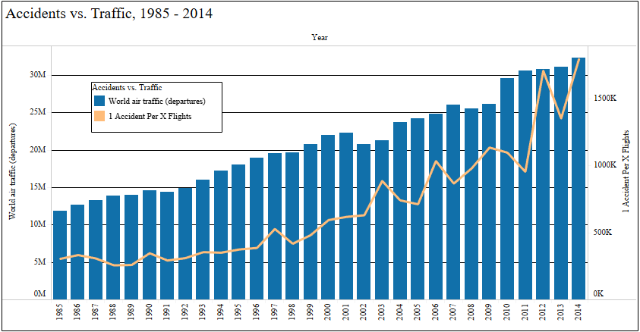
This last chart shows that although worldwide air traffic is increasing, the frequency of accidents is not – as we track the proportion of accidents which have occurred compared to the total amount of flights in the world, the odds of an accident occurring continuously get smaller, from 1 accident every 305704 flights in 1985 to 1 accident every 1796667 flights in 2014

Slide 7
Reduced risk with increasing travel
As our review of the data demonstrates, the number of air travel opportunities (with its corresponding amount of traffic) continues to increase – yet the actual accident and fatality rates continue to decline
Total flights which are completing their journeys without incident for every one accident continue to increase every year
Fatality and accident totals show a steady decline
Comparisons of the total number of accidents occurring each year compared to previous years show a strong decline in annual incidents as time moves on

